Slide 1
CSS Review – fundamentals and layout
IN712

Slide 2
CSS – Cascading Style Sheets
CSS is a W3C standard for describing the appearance of HTML elements
Mechanism for web authors to modify visual presentation of webpages
With CSS, we can assign font properties, colors, sizes, borders, background images and position elements on the page
Improved control over formatting
Improved site maintainability
All formatting can be centralized into one (or a small handful) CSS file/s
Improved accessibility
By keeping presentation out of the HTML, screen readers and other accessibility tools work better
Improved page download speed
Notes:
W3C Stands for World Wide Web Consortium

Slide 3
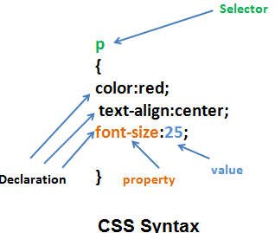
CSS syntax
A CSS document consist of one or more style rules
A rule consist of a selector that identifies the HTML element or elements that will be affected
Selectors are a pattern that is used by the browser to select the HTML elements that will receive the style
The selector is followed by a series of property: value pairs ( a declaration)
Property names are predefined by CSS
Properties are assigned values
Units are dependent upon the property
Predefined list of keywords
Length measurements
Percentages
…

Slide 4
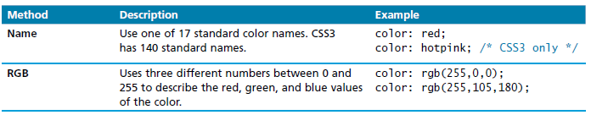
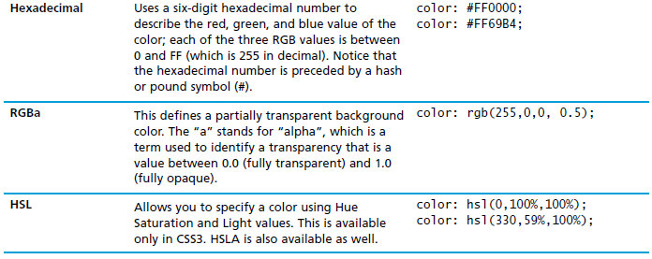
Color Methods

Slide 5
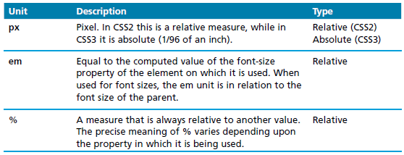
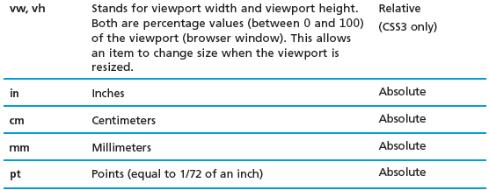
Units
Notes:
Relative length units specify a length relative to another length property. Relative length units scales better between different rendering mediums.
The absolute length units are fixed and a length expressed in any of these will appear as exactly that size. Absolute length units are not recommended for use on screen, because screen sizes vary so much. However, they can be used if the output medium is known, such as for print layout.

Slide 6

Location of the styles: in-line
Place within an HTML element via the style attribute
An in-line style only affects the element it is defined within
It overrides any other style definition
Using in-line styles is generally discouraged
Increases bandwidth consumption
Decreases maintainability
Presentation and content are intermixed
It can be challenging to make consistent in-line style changes across multiple files

Slide 7
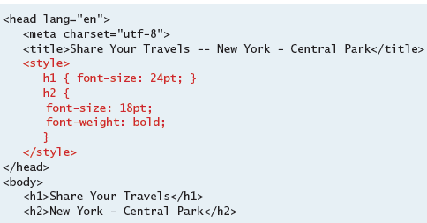
Location of the styles: embedded
Place within the <style> element inside the <head> element of an HTML document
Better than in-line styles but still discouraged
More difficult to consistently style multiple documents

Slide 8
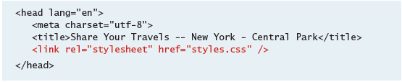
Location of the styles: external style sheet
Style rules placed within a external text file with the .css extension
Provides the best maintainability
When changes are made to an external style sheet, all HTML documents that reference that style sheet will automatically use the updated version
The browser is able to cache the external style sheet
Can improve the performance of the site as well

Slide 9
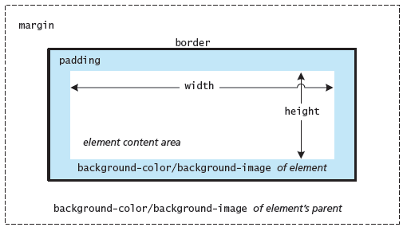
The box model
In CSS, all HTML elements exist within an element box

Slide 10
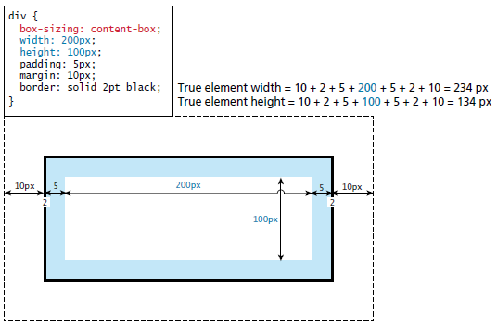
The box model

Slide 11
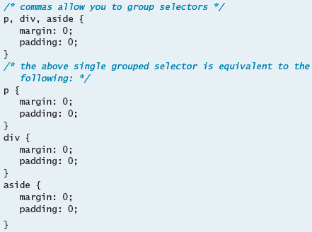
Element selectors
select all instances of a given HTML element

Slide 12
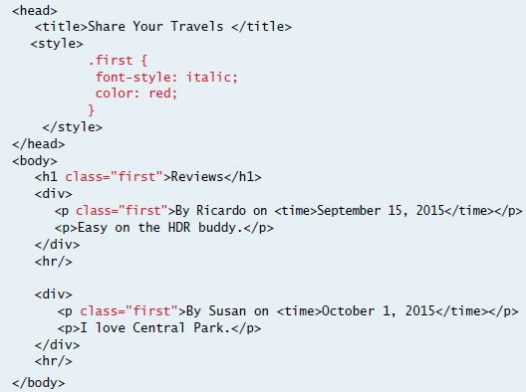
Class selectors
Allows to simultaneously target different HTML elements

Slide 13
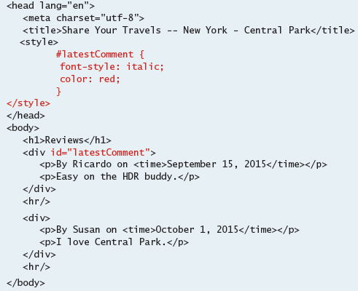
Id selectors
Allows the target a specific element by its id attribute

Slide 14
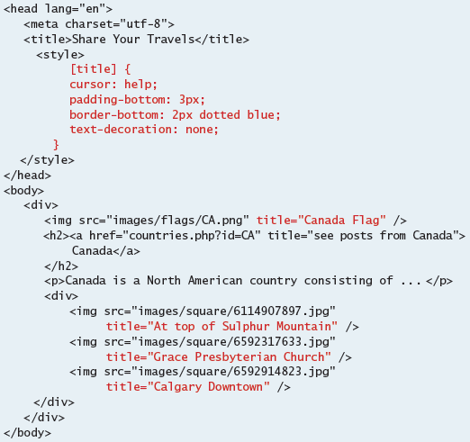
Attribute selectors
Provide a way to select HTML elements either by the presence of an element attribute or by the value of an attribute

Slide 15
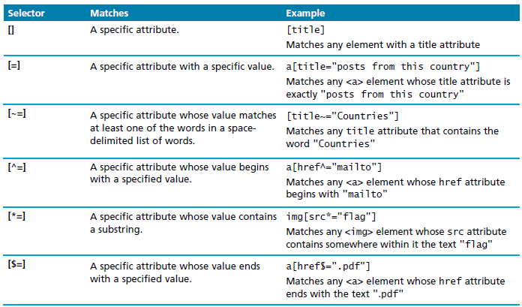
Attribute selectors

Slide 16
Pseudo-Element and Pseudo-Class Selectors
A pseudo-element selector is a way to select something that does not exist explicitly as an element in the HTML document tree but which is still a recognizable selectable object.
For instance, you can select the first line or first letter of any HTML element using a pseudo-element selector.
A pseudo-class selector does apply to an HTML element, but targets either a particular state or, in CSS3, a variety of family relationships.

Slide 17
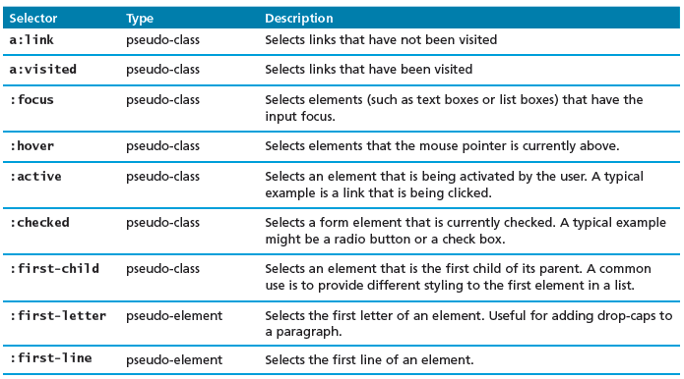
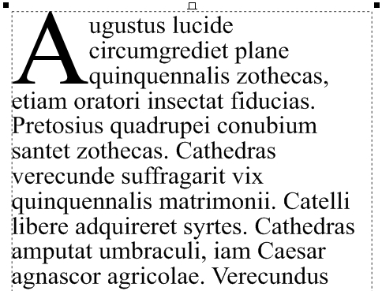
Pseudo-Element and Pseudo-Class Selectors

Slide 18
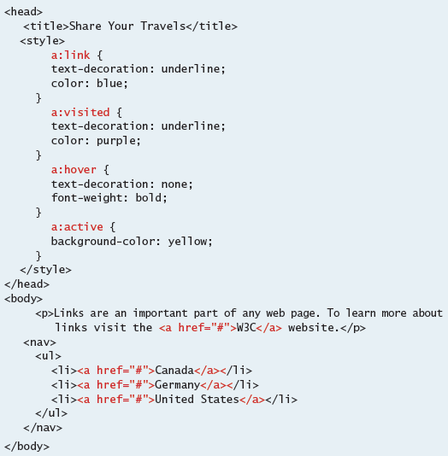
Pseudo-Element and Pseudo-Class Selectors

Slide 19
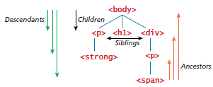
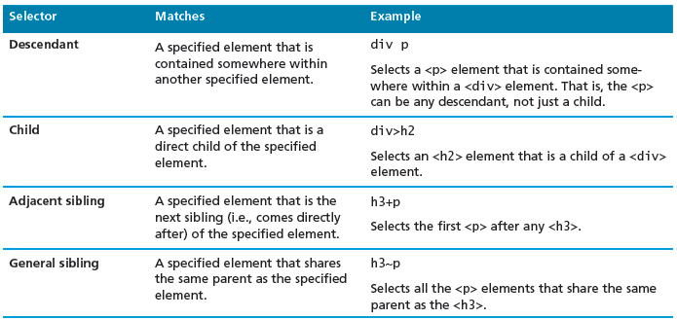
Contextual selectors
Allows you to select elements based on their ancestors, descendants or siblings

Slide 20
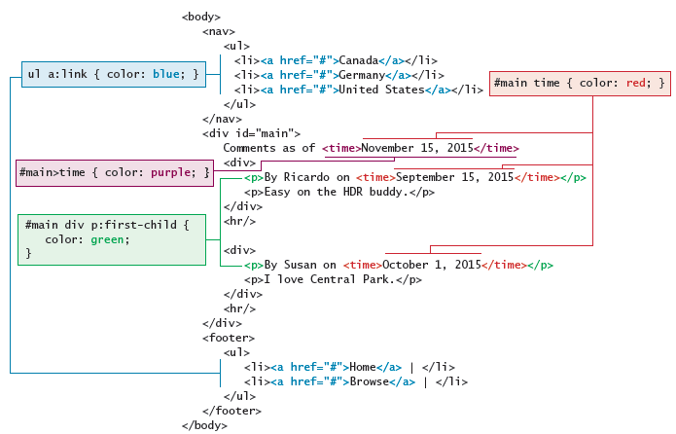
Contextual selectors

Slide 21
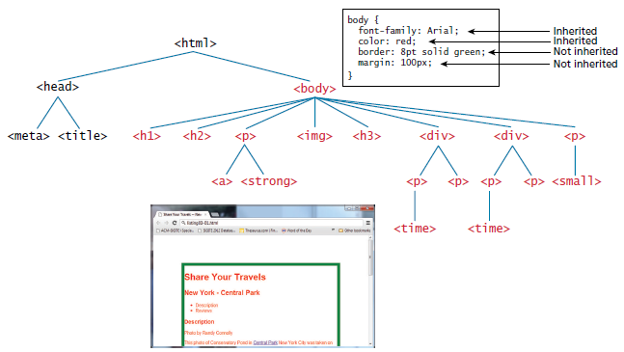
The Cascade: How Styles Interact
Inheritance: many but not all CSS properties affect not only themselves but their descendants as well

Slide 22
The Cascade: How Styles Interact
Specificity refers to how the browser determines which style rule takes precedence when more than one style rule could be applied to the same element
The browser assigns a weight to each style rule
When several rules apply, the one with the greatest weight takes precedence
The more specific the selector, the more it takes precedence
Class selectors take precedence over element selectors
id selectors take precedence over class selectors

Slide 23
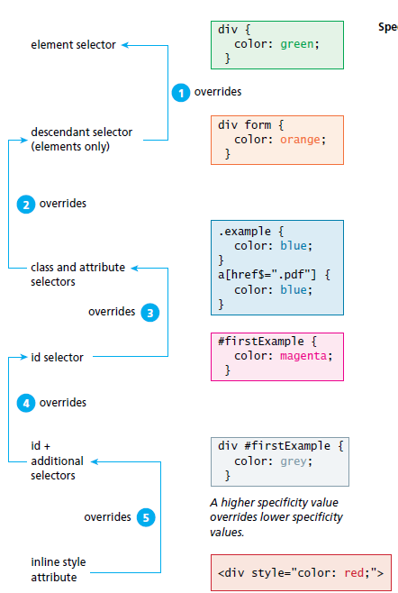
Specificity algorithm
Notes:
Location: when rules have the same specificity, the latest are given more weight
An in-line style will override one defined in an external style sheet or an embedded stylesheet
When the same style properties is defined multiple times within a single declaration block, the last one will take precedence

Slide 24
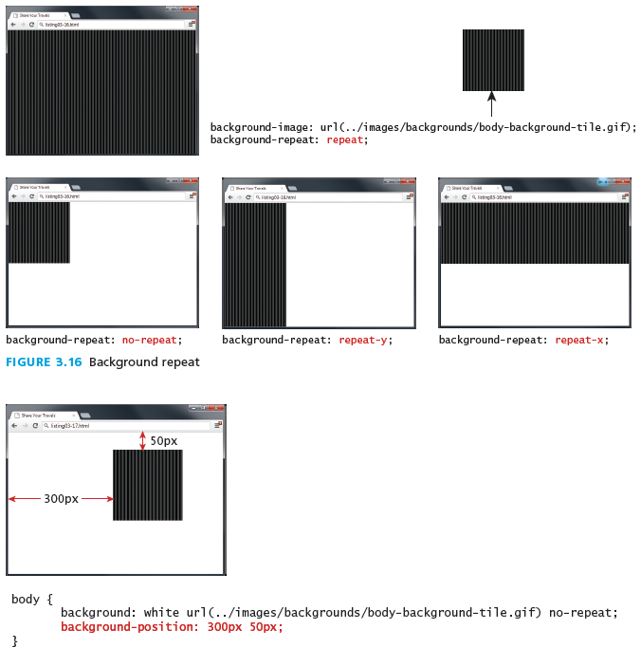
Background

Slide 25
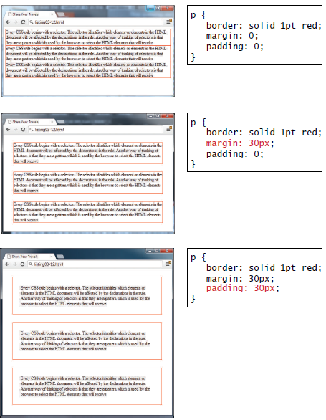
Borders, margins and padding

Slide 26
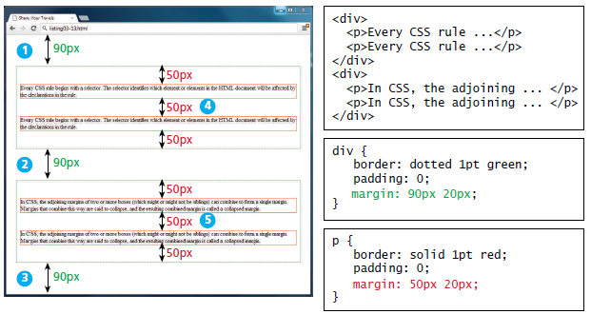
Collapsing vertical margins

Slide 27
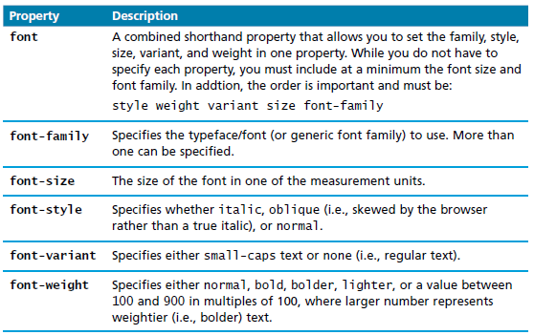
CSS text styling – font properties

Slide 28
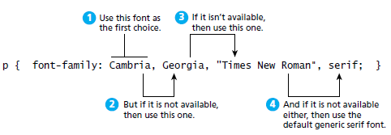
Specifying the font family

Slide 29
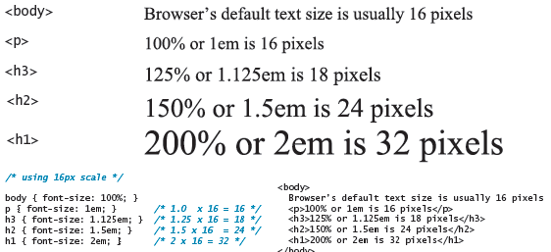
CSS text styling – font sizes

Slide 30
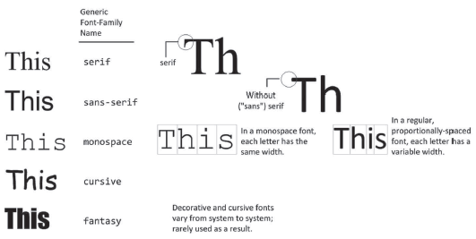
Different font families

Slide 31
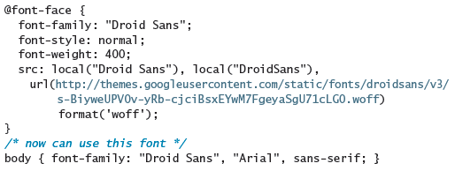
@font-face
With the @font-face rule, you do no longer need to use one of the "web-safe" fonts

Slide 32
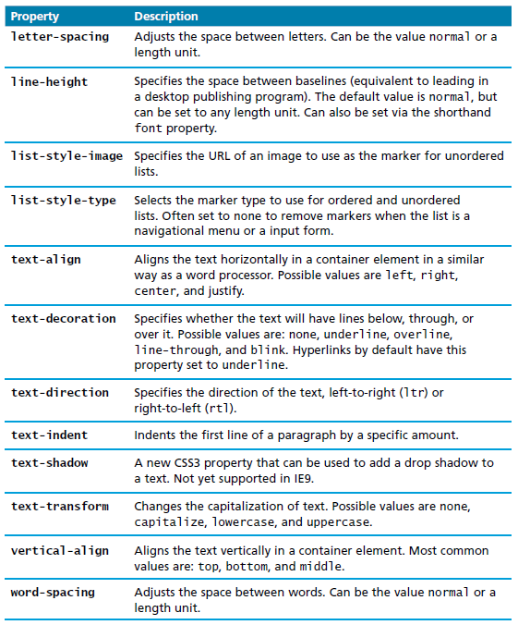
Text properties

Slide 33
Vendor prefixes
Some CSS3 features are so new that they are implemented differently in the different browsers and need a brower-specific “vendor prefix”.
-moz- prefix is for mozilla
-webkit- for Chrome and Safari
-o- for Opera
-ms- for Microsoft

Slide 34
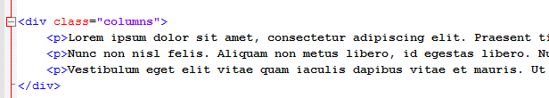
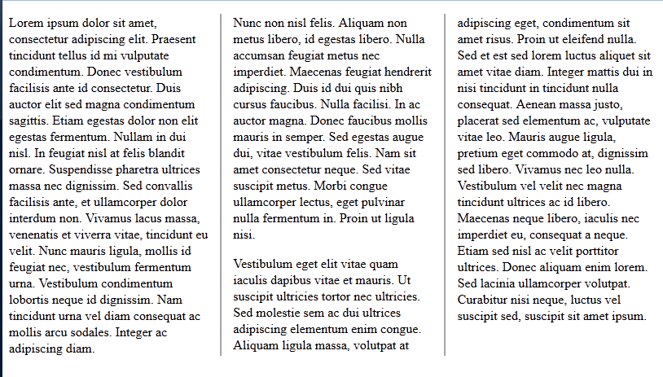
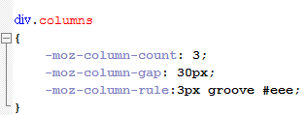
Columns

Slide 35
Demo
CSS Demo

Slide 36
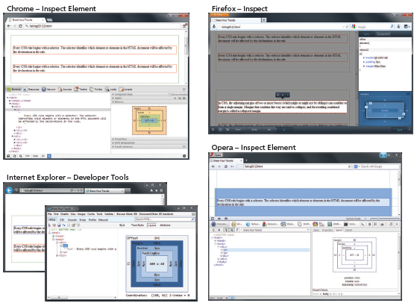
Inspecting CSS using developer tools within modern browsers

Slide 37
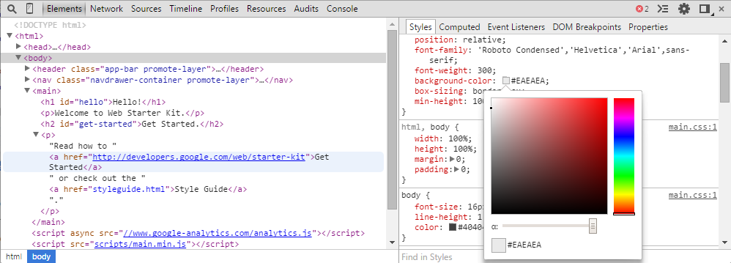
DevTools in Chrome
Ctrl+Shift+i or F12
Demo
Ctrl+Shift+j : focus on the console
Notes:
Provides lots of extremely useful debugging support for HTML, CSS and JavaScript
HTML, CSS and JavaScript have been traditionally very difficult to debug because you don’t really see them, you only see what the browser renders from them
We will see it with JavaScript working like a runtime debugger, but it is also very useful for CSS, even though there isn’t any runtime per se
Built directly into Chrome

Slide 38
CSS Layout

Slide 39
Elements Layout
HTML elements can be classified according to their default layout (normal flow) into:
Block level elements
each element is contained in its own line
begin with a line break
Use the normal CSS box model
<p>, <div>, <h2>, <ul>, and <table>
In-line elements
Do not form their own blocks
Instead are displayed within lines
Normal text, <em>,<a>, <img>, and <span>

Slide 40
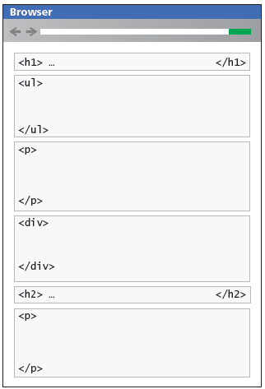
Block level Elements
Notes:
HTML (Hypertext Markup Language) elements are usually either "block-level" elements or "inline" elements. A block-level element occupies the entire space of its parent element (container), thereby creating a "block.“. Browsers typically display the block-level element with a newline both before and after the element. You can visualize them as a stack of boxes.

Slide 41
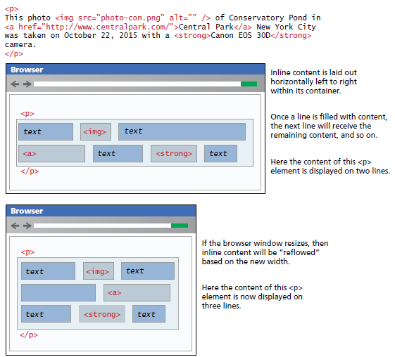
In-line elements
Notes:
HTML (Hypertext Markup Language) elements are usually "inline" elements or "block-level" elements. An inline element occupies only the space bounded by the tags that define the inline element.
By default, block-level elements begin on new lines, but inline elements can start anywhere in a line. Generally, block-level elements may contain inline elements and other block-level elements. Inherent in this structural distinction is the idea that block elements create "larger" structures than inline elements.

Slide 42
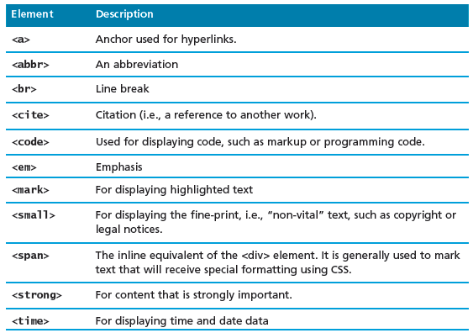
In-line text elements

Slide 43
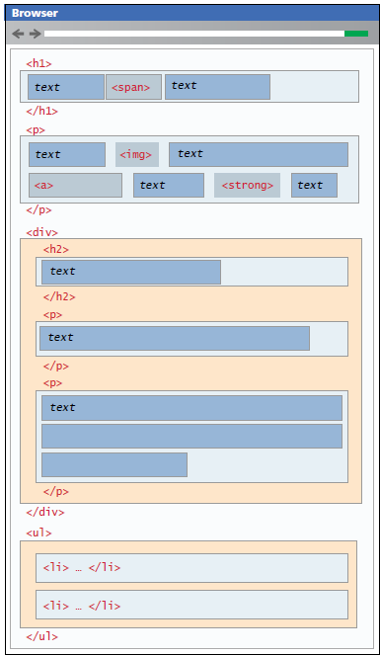
Block and in-line elements together

Slide 44
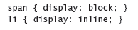
Changing the flow
It is possible to change whether an element is block-level or in line via the CSS display property.
These two rules will make all <span> elements behave like block level elements all <li> elements behave like in line elements (that is, each list item will be displayed on the same line)
Display: none
Can be used to turn on and off the display of an element
http://liveweave.com/6XscPS

Slide 45
Positioning elements
It is possible to move an item from its regular position in the normal flow
It is possible to position an item so it is always visible in a fixed position while the rest of the content scrolls
It is even possible to move an item outside of the browser viewport so it is not visible
The position property of CSS is used to specify the type of positioning

Slide 46
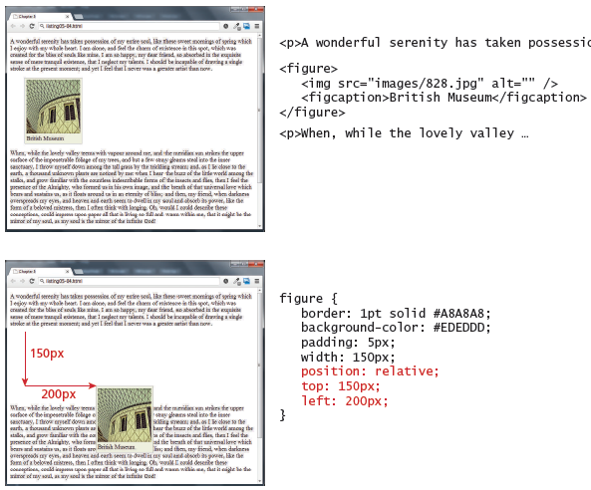
Static and Relative positioning
In relative positioning the element is offset with respect to its default positioning
Notes:
Static positioning is the default

Slide 47
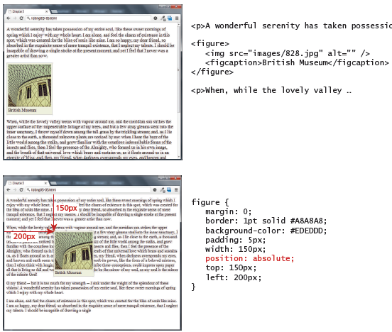
Absolute positioning
In absolute positioning the element is offset with respect to its 1st container element which is not static

Slide 48
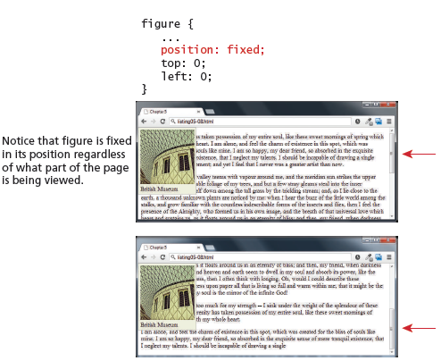
Fixed positioning

Slide 49
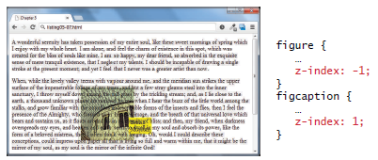
Z-index
It’s positioned element has a stacking order defined by the z-index property
Items closest to the viewer ( and thus on the top) have a larger z index

Slide 50
Creating Column Layouts – Absolute Positioning
http://liveweave.com/XM8QpU

Slide 51
Floating elements
An element can be displaced from its default position in the normal flow via their CSS float property
An element can be floated to the left or to the right of its container block
When an item is floated, it is moved all the way to the far left or far right of its containing block
The rest of the content is re-flowed around the floated element
A floated block level element must have a width specified
Otherwise it will implicitly filled the entire with of the containing block with no room available to flow content around the floated item

Slide 52
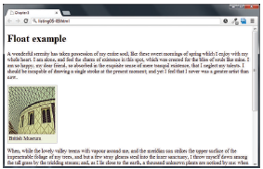
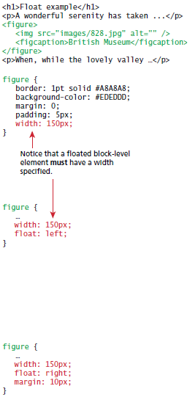
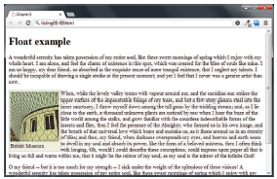
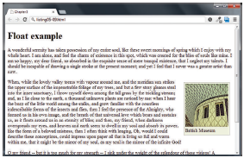
Floating elements

Slide 53
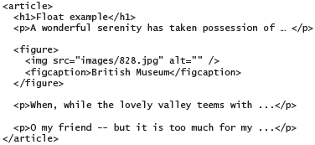

Floating elements

Slide 54

Problems with multiple floats

Slide 55

Using the clear property

Slide 56
Creating Column Layouts - Floats
http://liveweave.com/MSo3zr

Slide 57
Practical
Provided:
HTML
Image files if needed
Image captures of the outputs
You add the CSS.
Do not touch the HTML body except to add class and id attributes.

Slide 58
Some useful resources
Css3 generator: GUI based CSS generator
http://layerstyles.org/builder.html : GUI based CSS generator
Csslint.net: CSS error detection
http://www.w3schools.com/css/default.asp: Documentation
http://liveweave.com/: Live coding

Slide 59
Remember!
No physical class on Tuesday, 21/2/77
But you are responsible for covering the online class material
Normal class on Thursday, 23/2/17

Slide 60
References
Fundamentals of Web Development

